Slide 1
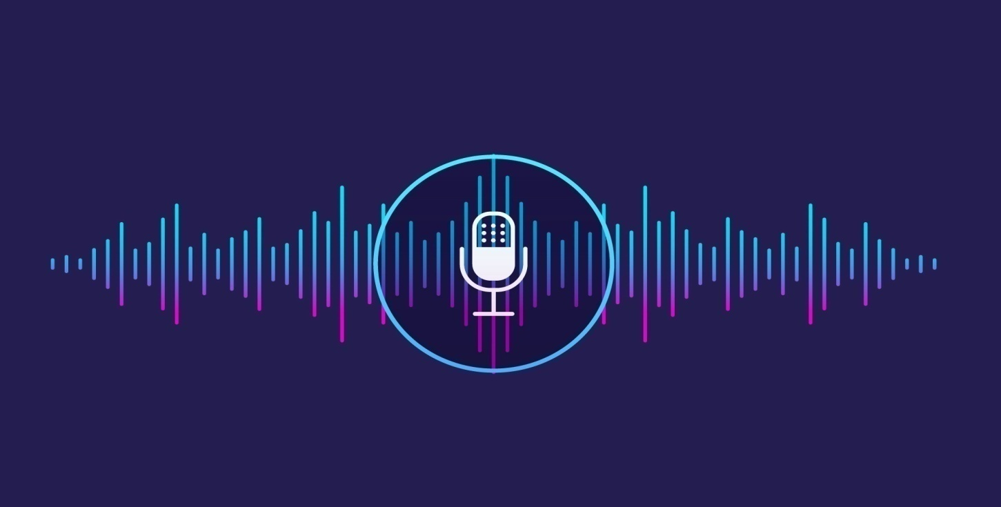
Voice Assistant using Python

Slide 2
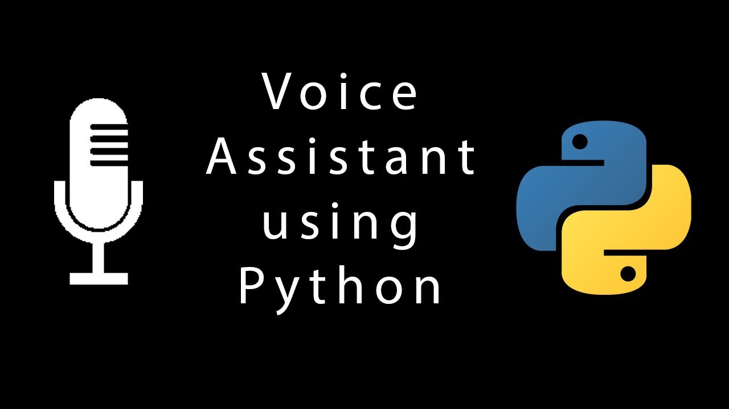
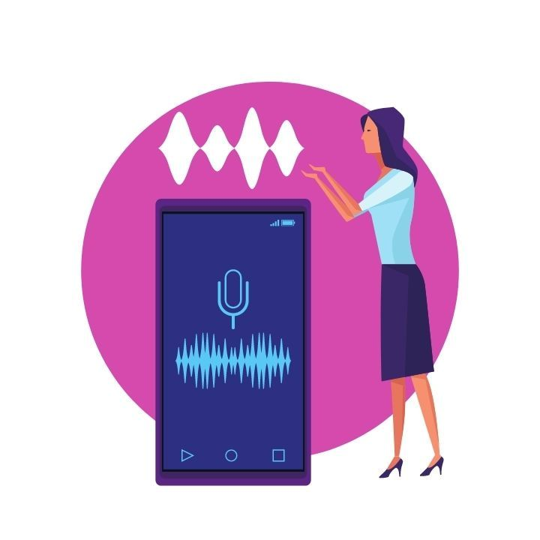
INDEX
About Voice Assistant (SELENA)
What can it (SELENA) do?
How it works?
Data flow Diagram
Hardware & System requirements
Virtual library requirements
Advantages
Disadvantages
Conclusion

Slide 3

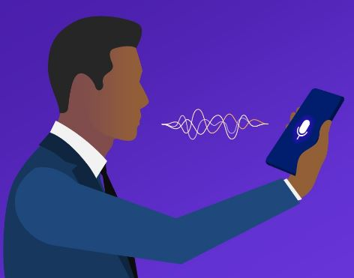
About Voice assistant (Selena)
‘Hey SELENA’ is a Virtual Assistant technology based on Artificial Intelligence.
This software program use device’s microphone to receive voice requests and processing on it, and sends response via Speaker.
Uses combination of different technologies like Voice Recognition, Language Processing , Voice Analysis.
Built and developed using python language and his modules

Slide 4


What can it (selena) do
What can Assistant do?
Controls your music.
Tells time.
Plays content from YouTube using any websites.
Asks Jokes.
Search information through Wikipedia.

Slide 5

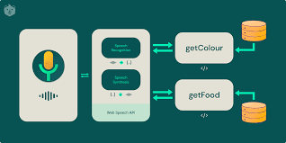
How it works?
User ask the Assistant to perform the task.
The natural language audio signal is converted into digital data that can be analyzed by the software.
Compared with a database of the software using an innovative algorithm to find a suitable answer.
This database is located on distributed servers in cloud networks.
For this reason, it must have a reliable Internet connection.

Slide 6
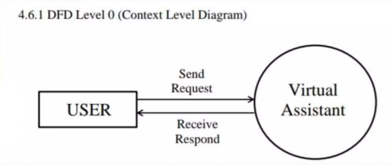
Data flow Diagram

Slide 7
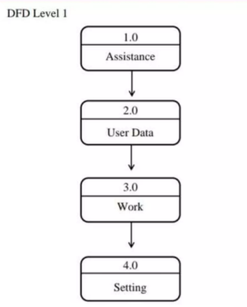
Data Flow diagram(lvl 1)

Slide 8
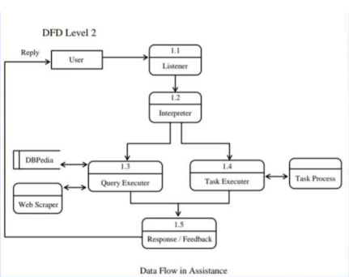
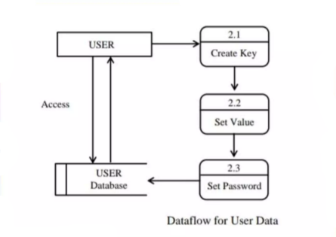
Data flow diagram(lvl 2)

Slide 9
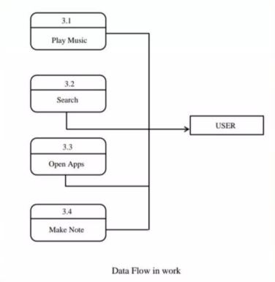
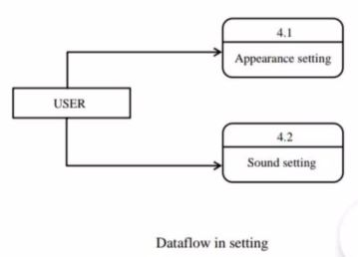
Data flow diagram(lvl 3)

Slide 10


Hardware & system requirements
Hardware Requirements
Sound Cards
Microphones
Processors/Computer
System Requirements
1.6GHz Processor.
512 GB or more of RAM.
Sound Cards with very clear signals.
High quality microphones.

Slide 11


Virtual library requirements
Speech Recognition
pip install SpeechRecognition
Pyttsx3
pip installpyttsx3
Wikipedia
pip install Wikipedia
Request
pip install request
PyAudio
pip install PyAudio
Data Time

Slide 12


Advantages
Advantages of Voice Assistant
Easily configured to perform many of regular tasks by simply giving voice command.
Able to write the text through both keyboard and voice input.
Different notepad commands such as open save clear etc.
Advantages of Voice Assistant
Voice based search that is a boon for many like senior citizens who are not comfortable using the keypad/ keyboard.
Requires less consumption of time in writing text.
Lower operational cost.

Slide 13
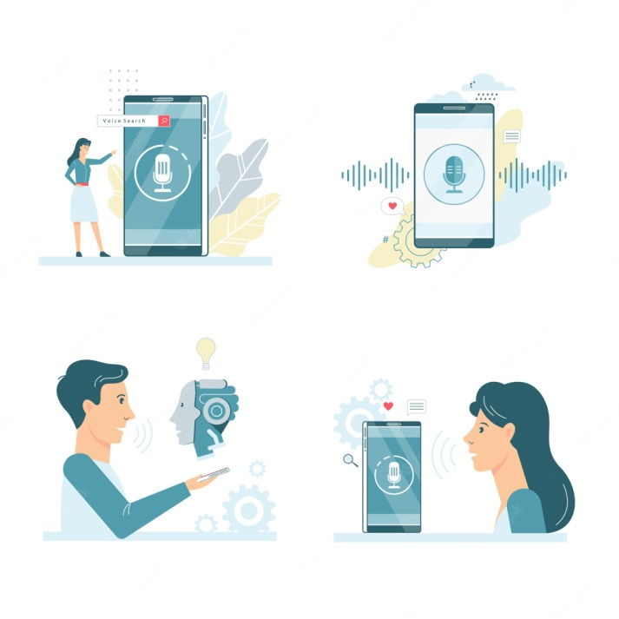

Disadvantages
Disadvantages of Virtual Assistant
A user has to speak much louder and slower than their normal speed and volume.
Not good in noisy place.
Low accuracy

Slide 14

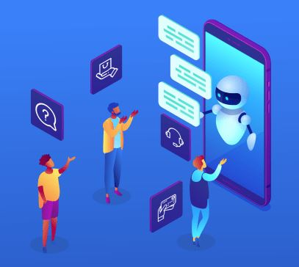
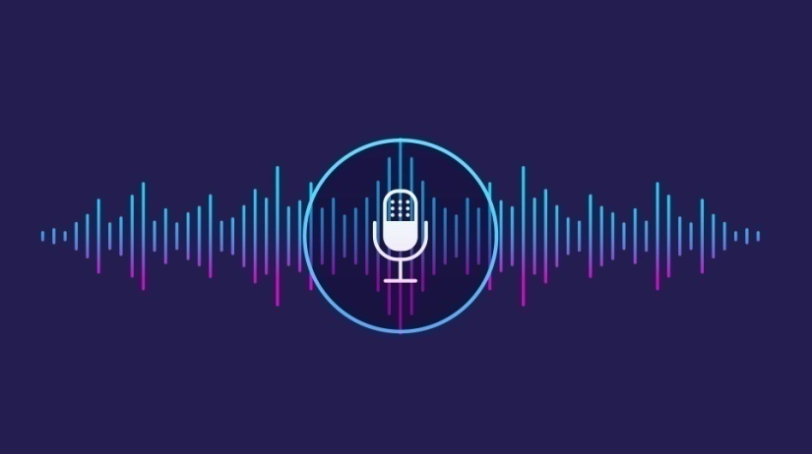
Conclusion
This presentation is a blueprint of ‘Hey Selena’ virtual assistant. In this project we discuss about how what is this software and how it performed.
With respect to less cost and less disadvantages we can say that, this system can have good future.

Slide 15
Thank you
Presentation By: Divyanshu Gupta (BCA 2nd Year)
Divyansh Chaurasia (BCA 2nd Year)
Abdullah Anzar (BCA 2nd Year)
Parv Gupta (BCA 2nd Year)
Vinayak Rathore (BCA 2nd Year)

